Slide 1
Java/J2EE Session- 21
Client Side Validation
And
AJAX

Slide 2
Contents.
Sample Examples in Java Script
Introduction to AJAX.
Advantages of AJAX.
Components of AJAX.
Sample application using AJAX.

Slide 3
Sample Examples in Java Script
JavaScriptExamples:
  See Session21Web for various client side validations using Java Script.

Slide 4
Introduction to AJAX
AJAX – Asynchronous JavaScript and XML.
AJAX is not a new programming language but a new way to use the existing standards.
AJAX is the art of exchanging data between client and server
Classic web pages (which do not use AJAX) must reload the entire page if the content to be changed.
Examples of application using AJAX are Google maps, Gmail, Youtube, Facebook etc.

Slide 5
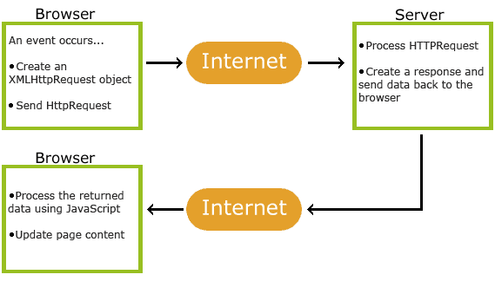
How AJAX works

Slide 6
AJAX is Based on Internet Standards
AJAX is based on Internet Standards, and uses the combination of
  XMLHTTPRequest (to exchange the request asynchronously).
  JavaScript/DOM (To display/interact with the information).
  CSS (to style the data).
  XML (often used as the format for transferring data).

Slide 7
Advantages of AJAX
With Ajax page can be refreshed automatically.
The response of the interfaces to the actions of the user is much faster.
Since the HTML is generated within a browser via the JavaScirpt, the ajax page seem to load much faster.
Separation of data like Content and the Structure of the web pages makes Ajax to load much faster.

Slide 8
Disadvantages of AJAX
The biggest problem is the integration of the browser.
The page that is created dynamically will not automatically register with the browsers history. So, clicking on the browser is back button might not function correctly.
We can’t bookmark the pages that created by AJAX as we have generated the page using AJAX.

Slide 9
Components of AJAX
The XMLHttpRequest Object
  All Modern browsers support the XMLHttpRequest object (IE5 and IE6 use ActiveXObject).
  The XMLHttpRequest object is used to exchange data with a server behind the scenes. This means that it is possible to update parts of a web page, without reloading the whole page.
How to create XMLHttpRequest.
  xmlHttp = new XMLHttpRequest();
Older versions like (IE5 and IE6) use.
  xmlHttp = new ActiveXObject(Microsoft.XMLHTTP);

Slide 10
Components of AJAX
To handle the request to be created in multiple browsers we can use the below code. Which creates the xmlHTTP object across all the brosers
  if (window.XMLHttpRequest)
  {
  // code for IE7+, Firefox, Chrome, Opera, Safari
  xmlhttp=new XMLHttpRequest();
  }
  else
  {
  // code for IE6, IE5
  xmlhttp=new ActiveXObject("Microsoft.XMLHTTP");
  }

Slide 11
Components of AJAX
Send a request to server:
  To send a request to the server we need to use open and send methods of XMLHttpRequest.
  xmlhttp.open("GET","ajax_info.txt",true);
    Specifies the type of request, the URL, and if the request should be handled asynchronously or not.
    Method : The type of request GET or POST
    URL : The loation of the file on the server
    Async : true (Asynchronous) and false (synchronous).
  xmlhttp.send(string);
    Send the request of to the server.
    String : only used for POST Requests.

Slide 12
Components of AJAX
Server Response:
  To get the response from the server we need to use responseText or responseXML properties of XMLHttpRequest object.
  responseText:
    This return the response in the form of Text.
  responseXML:
    This return the response in the form of XML.

Slide 13
Components of AJAX
Onreadystatechange Event:
  When a request is sent to server, we want to perform some actions based on the response
  The onreadystatechange even is triggered everytime the ready state changes.
  The ready state property holds the status of XMLHttpRequest object
  The important properties of XMLHttpRequest object are:
  Onreadystatechange : Stores a function (the name or the function) to be called automatically each time when the ready state property changes
  readyState: holds the status of the XMLHttpRequest.
    0 → Request not Initialized
    1 → Server connection established
    2 → Request received
    3 → Processing request
    4 → Request finished and response is ready.

Slide 14
Components of AJAX
status: Holds the current staus
  200 → Success response “OK”.
  404 → Page not found.
Example
  Session21Web

Slide 15

Questions??

